Slide 1
Backpropagation
Neural Networks

Slide 2
MLP Architecture
Consider an MLP with:
One input: x
Two hidden neurons: h₁ and h₂
Weights and biases for hidden neurons: w_{1,1}, w_{1,2}, b_{1,1}, and b_{1,2}
Activation functions for hidden neurons: f₁ and f₂
One output neuron: yˆ
Weights and bias for output neuron: w_{2,1}, w_{2,2}, and b₂
Ground truth: y

Slide 3
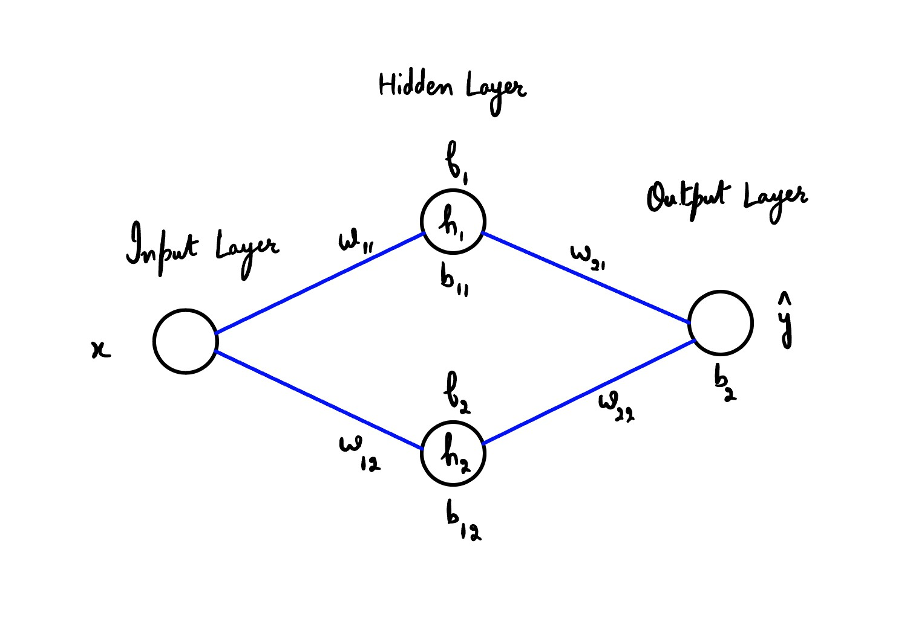
MLP Architecture

Slide 4
Hidden Layer and Output
The outputs of the hidden neurons are:
h₁ = f₁(w_{1,1}x + b_{1,1})
h₂ = f₂(w_{1,2}x + b_{1,2})
The output of the network is:
yˆ = w_{2,1}h₁ + w_{2,2}h₂ + b₂

Slide 5
Loss Function
Compute the loss function using the mean squared error (MSE) loss:
1
2
L = ₂ (y − yˆ)

Slide 6
Compute Gradients for Output Layer
Compute the gradients for the output layer:
∂L
= −(y − yˆ) · h₁
∂w₂
,1
∂L
= −(y − yˆ) · h₂
∂w₂
,2
∂L
∂b₂
= −(y − yˆ)

Slide 7
Compute Gradients for Hidden Layer
Compute the gradients for the hidden layer:
∂L
= −(y − yˆ) · w₂ · f ′(w x + b ) · x
,1 1,1
1,1
∂w1,1
∂L
1
= −(y − yˆ) · w₂ · f ′(w x + b )
,1 1,1
1,1
∂b1,1
∂L
1
= −(y − yˆ) · w₂ · f ′(w x + b ) · x
,2 1,2
1,2
∂w1,2
∂L
2
= −(y − yˆ) · w₂ · f ′(w x + b )
,2 1,2
1,2
∂b1,2
2

Slide 8
Update Parameters with Gradient Descent
Update the parameters using gradient descent with a learning rate α:
∂L
w = w − α
1,1 1,1
∂w
1,1
∂L
b = b − α
1,1 1,1
∂b
1,1
∂L
w = w − α
1,2 1,2
∂w
1,2
∂L
b = b − α
1,2 1,2
∂b
1,2
∂L
w = w − α
2,1 2,1
∂w
2,1
∂L
w = w − α
2,2 2,2
∂w
2,2
∂L
b₂ = b₂ − α_{∂b2}

Slide 9
Summary
We derived the backpropagation mathematics for an MLP with one input, two hidden neurons, and one output neuron.
We computed the gradients for the hidden and output layers.
We updated the parameters using gradient descent with a learning rate α.
Iterate this process for multiple training examples and epochs to train the network.

Slide 10
MLP Architecture
Consider an MLP with:
Two inputs: x₁ and x₂
One hidden layer with 3 neurons: h₁, h₂, and h₃
Weights and biases for hidden neurons: w_{1,1}, w_{1,2}, w_{1,3}, w_{2,1}, w_{2,2}, w2,3, b1,1, b1,2, and b1,3
Activation functions for hidden neurons: f₁, f₂, and f₃
One output neuron: yˆ
Weights and bias for output neuron: w_{3,1}, w_{3,2}, w_{3,3}, and b₃
Ground truth: y

Slide 11
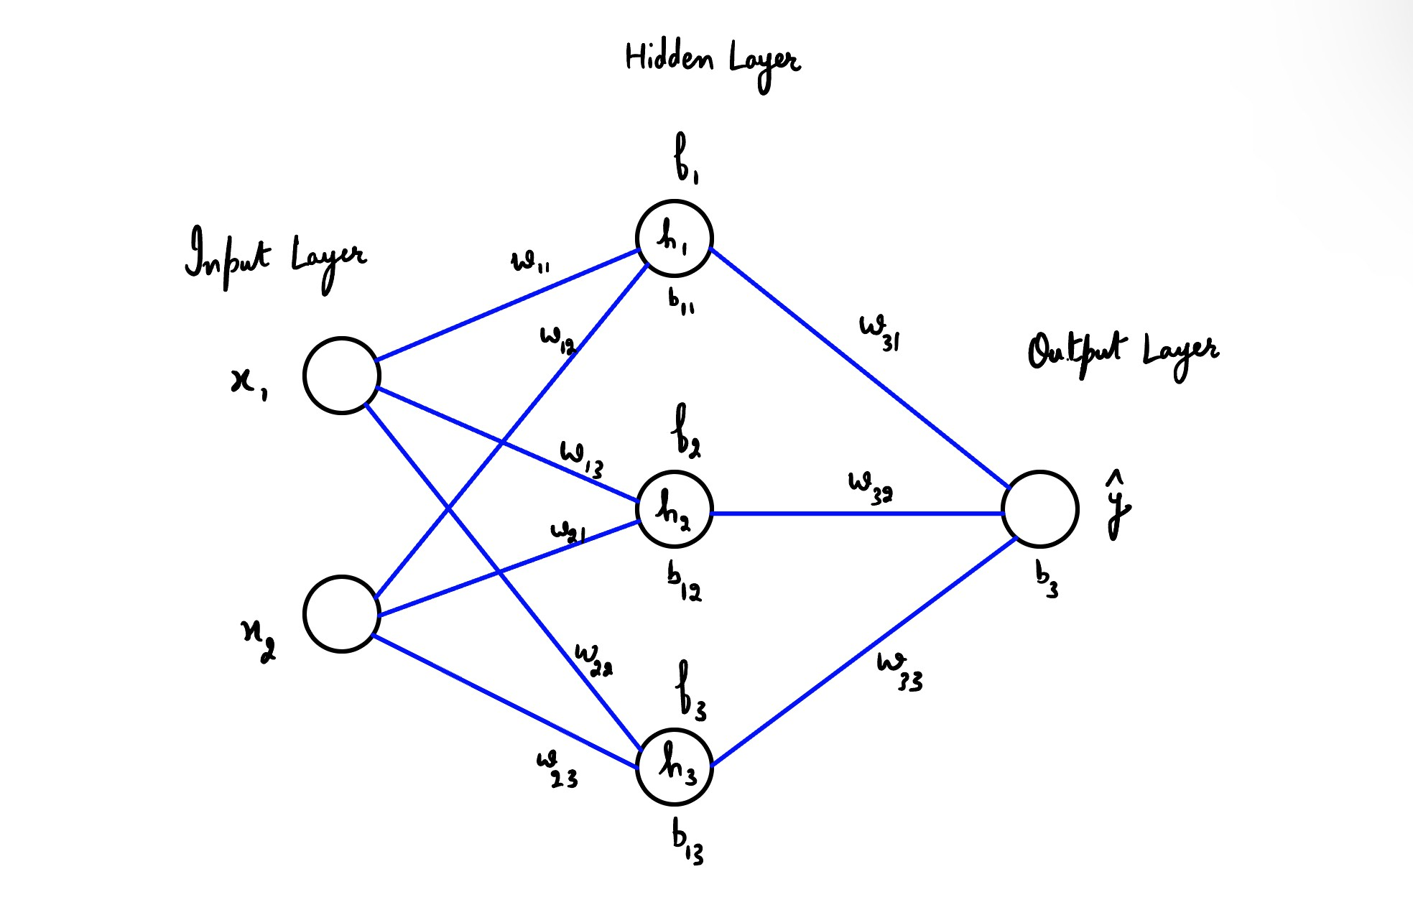
MLP Architecture

Slide 12
Hidden Layer and Output
The outputs of the hidden neurons are:
h1 = f1(w1,1x1 + w2,1x2 + b1,1) h2 = f2(w1,2x1 + w2,2x2 + b1,2) h3 = f3(w1,3x1 + w2,3x2 + b1,3)
The output of the network is:
yˆ = w_{3,1}h₁ + w_{3,2}h₂ + w_{3,3}h₃ + b₃

Slide 13
Loss Function
Compute the loss function using the mean squared error (MSE) loss:
1
2
L = ₂ (y − yˆ)

Slide 14
Compute Gradients for Output Layer
Compute the gradients for the output layer:
∂L
= −(y − yˆ) · h₁
∂w₃
,1
∂L
= −(y − yˆ) · h₂
∂w₃
,2
∂L
= −(y − yˆ) · h₃
∂w₃
,3
∂L
∂b₃
= −(y − yˆ)

Slide 15
Compute Gradients for Hidden Layer
Compute the gradients for the hidden layer:
∂L
= −(y − yˆ) · w₃ · f ′(w x + w x + b ) · x
,1 1,1 1 2,1 2 1,1 1
∂w1,1
∂L
1
= −(y − yˆ) · w₃ · f ′(w x + w x + b ) · x
,1 1,1 1 2,1 2 1,1 2
∂w2,1
∂L
1
= −(y − yˆ) · w₃ · f ′(w x + w x + b ) · x
,2 1,2 1 2,2 2 1,2 1
∂w1,2
∂L
2
= −(y − yˆ) · w₃ · f ′(w x + w x + b ) · x
,2 1,2 1 2,2 2 1,2 2
∂w2,2
2

Slide 16
Compute Gradients for Hidden Layer
Compute the gradients for the hidden layer (continued):
∂L
= −(y − yˆ) · w₃ · f ′(w x + w x + b ) · x
,3 1,3 1 2,3 2 1,3 1
∂w1,3
∂L
3
= −(y − yˆ) · w₃ · f ′(w x + w x + b ) · x
,3 1,3 1 2,3 2 1,3 2
∂w2,3
∂L
3
= −(y − yˆ) · w₃ · f ′(w x + w x + b )
,1 1,1 1 2,1 2 1,1
∂b1,1
∂L
1
= −(y − yˆ) · w₃ · f ′(w x + w x + b )
,2 1,2 1 2,2 2 1,2
∂b1,2
∂L
2
= −(y − yˆ) · w₃ · f ′(w x + w x + b )
,3 1,3 1 2,3 2 1,3
∂b1,3
3

Slide 17
Update Parameters with Gradient Descent
Update the parameters using gradient descent with a learning rate α:
∂L
w = w − α
1,1 1,1
∂w
1,1
∂L
w = w − α
2,1 2,1
∂w
2,1
∂L
w = w − α
1,2 1,2
∂w
1,2
∂L
w = w − α
2,2 2,2
∂w
2,2
∂L
w = w − α
1,3 1,3
∂w
1,3
∂L
w = w − α
2,3 2,3
∂w
2,3

Slide 18
Update Parameters with Gradient Descent
Update the parameters using gradient descent with a learning rate α:
∂L
b = b − α
1,1 1,1
∂b
1,1
∂L
b = b − α
1,2 1,2
∂b
1,2
∂L
b = b − α
1,3 1,3
∂b
1,3
∂L
w = w − α
3,1 3,1
∂w
3,1
∂L
w = w − α
3,2 3,2
∂w
3,2
∂L
w = w − α
3,3 3,3
∂w
3,3
∂L
b₃ = b₃ − α_{∂b3}

Slide 19
Summary
We derived the backpropagation mathematics for an MLP with 2 inputs, one hidden layer with 3 neurons, and one output neuron.
We computed the gradients for the hidden and output layers.
We updated the parameters using gradient descent with a learning rate α.
Iterate this process for multiple training examples and epochs to train the network.

Slide 20
General MLP Architecture
Consider an MLP with:
n inputs: x = (x₁, x₂, . . . , x_{n})
k hidden layers with N_{i} neurons in each layer: h^{(l)} for layer l , neuron i
i
Weights and biases for each neuron in hidden layers: w ^{(l)} and b^{(l)}
i,j
(l)
Activation functions for each neuron in hidden layers: f_{i}
m output neurons: yˆ = (yˆ₁, yˆ₂, . . . , yˆ_{m})
i
Weights and biases for output neurons: w
Ground truth: y = (y₁, y₂, . . . , y_{m})
(k+1)
i,j
and b
(k+1)
i

Slide 21
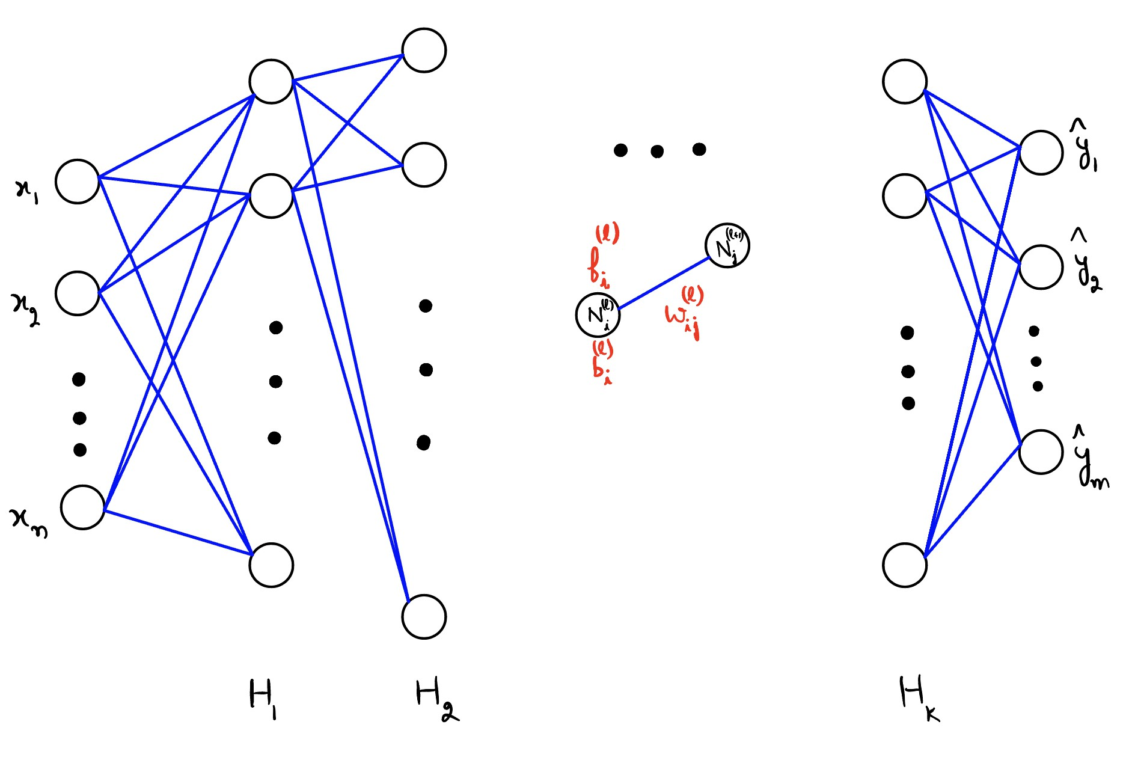
General MLP Architecture

Slide 22
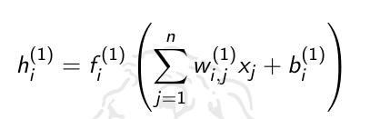

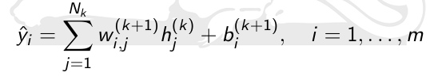
Hidden Layers and Output
The outputs of the neurons in the hidden layers are:
The outputs of the network are:

Slide 23
Loss Function
Compute the loss function using the mean squared error (MSE) loss:
1
2
m
L =
2
Σ
i =1
(y_{i} − yˆ_{i} )

Slide 24
Compute Gradients for Output Layer
Compute the gradients for the output layer:
∂L
= −(y − yˆ ) · h^{(k)}
_{∂w} (k+1)
i i
j
i,j
∂L
_{(k+1)} = −(y_{i} − yˆ_{i} )
∂b_{i}

Slide 25
Backpropagation Algorithm Overview
The backpropagation algorithm consists of the following steps:
Perform a forward pass through the network to compute the outputs.
Calculate the gradients for the output layer.
Propagate the gradients back through the hidden layers.
Update the weights and biases using the calculated gradients and a learning rate α.

Slide 26
Gradients for Hidden Layers
Compute the gradients for the hidden layers:
For each layer l from k to 1 and each neuron i in that layer:
  Calculate the gradient of the loss with respect to the weighted input of neuron i in layer l .
  Calculate the gradients of the loss with respect to the weights and biases of neuron i in layer l using the chain rule.

Slide 27
Update Parameters with Gradient Descent
Update the parameters using gradient descent with a learning rate α:
For each layer l from 1 to k + 1 and each neuron i in that layer:
  Update the weights and biases using the calculated gradients:
_{w} (l) _{= w} (l) _{− α} ∂L
i,j i,j
_{∂w} (l)
i,j
_{b}(l) _{= b}(l) _{− α} ∂L
i i
_{∂b}(l)
i

Slide 28
Activation Functions
Activation functions introduce non-linearity into the network, enabling it to learn complex patterns. Common activation functions include:
Sigmoid: σ(x ) =
1
1+e
−x
Hyperbolic Tangent (tanh): tanh(x ) = ^{ex −e−x}
_{e}x _{+e}−x
Rectified Linear Unit (ReLU): ReLU(x ) = max(0, x )

Slide 29
Regularization
Regularization techniques can be used to prevent overfitting in the MLP:
L1 and L2 regularization: Add a penalty term to the loss function based on the weights’ magnitude.
Dropout: During training, randomly set the output of some neurons to zero with a given probability.

Slide 30
Stopping Criteria
Stopping criteria determine when to stop training the network:
Maximum number of epochs: Stop training after a predefined number of epochs.
Early stopping: Monitor the performance on a validation set and stop training when the performance stops improving or starts degrading.

Slide 31
Optimization Algorithms
Optimization algorithms update the weights and biases to minimize the loss function:
Gradient Descent: The simplest optimization algorithm, updates parameters based on gradients and learning rate.
Momentum: Adds a momentum term to gradient descent, which accelerates convergence and reduces oscillations.
Adaptive learning rate methods: Adjust the learning rate during training, e.g., AdaGrad, RMSprop, and Adam.

Slide 32
Applications
MLPs can be applied to a variety of tasks, including:
Regression: Predicting continuous values, e.g., housing prices, stock prices.
Classification: Categorizing input data into classes, e.g., handwritten digit recognition, spam detection.

Slide 33
Challenges and Limitations
Vanishing and exploding gradients: Deep MLPs may suffer from vanishing or exploding gradients, making it difficult to train the network effectively.
Overfitting: MLPs with a large number of parameters are prone to overfitting, which can be mitigated using regularization techniques.
Local minima: The optimization algorithm may get stuck in local minima, leading to suboptimal solutions.
Model selection: Choosing the optimal architecture, activation functions, and other hyperparameters requires experimentation and can be time-consuming.

Slide 34
Alternatives and Improvements
Convolutional Neural Networks (CNNs): Designed for image processing, CNNs can outperform MLPs in tasks like image classification.
Recurrent Neural Networks (RNNs): Suitable for sequential data, RNNs can process time series, natural language, and other ordered data.
Long Short-Term Memory (LSTM) and Gated Recurrent Units (GRU): These networks address the vanishing gradient problem in RNNs.
Transfer learning: Pre-trained models can be fine-tuned for specific tasks, reducing training time and improving performance.

